Slide 1
S. No. | Parameters |  | Su-vastika PSW 1050/12V | Microtek SW 1100/12V
 |  |  | Specified Value | Specified Value
1. | Capacity |  | 950VA | 950VA
2. | Nominal Battery Voltage |  | 12VDC | 12VDC
3. | Specified Load |  | 640W | 760W
 | No Load Current |  | 1.42A | 1.79A
4. | Mains Input Range | Mains AC low cut UPS Mode | 178VAC | 179VAC
 |  | Mains AC low cut recovery UPS Mode | 189VAC | 187VAC
 |  | Mains AC high cut UPS Mode | 264VAC | 263VAC
 |  | Mains AC high cut recovery UPS Mode | 256VAC | 254VAC
 |  | Mains AC low cut W-UPS Mode | 106VAC | 80VAC
 |  | Mains AC low cut recovery W-UPS Mode | 112VAC | 96VAC
 |  | Mains AC high cut W-UPS Mode | 282VAC | 295VAC
 |  | Mains AC high cut recovery W-UPS Mode | 272VAC | 285VAC
 |  | Frequency Bypass range | 50.01Hz | 50.01Hz
5. | Output Mains Mode | Voltage Window | Same as Input | Same as Input
6. | Output Inverter Mode | Wave Form | Pure Sinewave | Pure Sinewave
 |  | Frequency | 50Hz | 50Hz
 |  | Regulation | 184VAC ~ 214VAC | 183VAC ~ 233VAC
 |  | Peak Efficiency at Resistive load | 74% | 70%
7. | Battery | Battery Types | Tubular/SMF/LA | STD./HIGH
 |  | Charging Current | 14.1A | 8.7A
 |  |  | 17.4A | 13.4A
 |  | Low Battery Warning | 11V (Tubular/SMF ) | NA
 |  |  | 11.18V LA | NA
 |  | Low Cut Battery | 10.5V | 10.99V
 |  |  | 11V | 10.99V
 |  | Battery Boost Charging Voltage | 14.4V (Tubular/SMF) | 14.45VDC (high)
 |  |  | 13.9V(LA) | 14.15VDC (STD)
 |  | Battery Float Charging Voltage | 13.6V | 13.9VDC
8. | Transfer Time | Backup to Mains | 3.8ms | 3.8ms
 |  | Mains to Backup | 8.4ms | 14.3ms
9. | Protection | Over Load in backup mode | >105% Load with 8-times Auto-reset | >105% load system shutdown
 |  | Short circuit (300% Load) | Yes, with 4-times auto reset | System Shutdown
 |  | Short Circuit at Input Side | Input MCB Trip in 15sec. | Input Reset switch open in 2 minutes

Slide 2
 |  | Su-vastika | Microtek | Remarks
1 | Specified Load | 640W | 760W | The high power drawn from the same rating of the inverters have the number of implications, including: Reduced inverter efficiency, Overheating, Potential for damage to connected devices, high MOSFET failure, inverter's lifespan may be shorter.
2 | Transformer | AL+Co. | AL | Aluminium+copper transformers offer a number of advantages over Aluminium transformers, including reduced weight, size, & losses. They also offer similar performance and heat dissipation capabilities as copper transformers. The cost of an Aluminium+ copper transformer is higher than an aluminium transformer. However, Aluminium+ copper transformers have a higher conductivity than Aluminium transformers.
3 | MOSFET used | SVG076R5NT | FTP03N03N | SVG076R5NT is the MOSFET of 7000W and FTP03N03N is the MOSFET of 4500W. FTP03N03N MOSFETs have a higher switching time than SVG076R5NT MOSFETs.
4 | Noise | No Noise on load | Vibration and shrill Noise | Vibration and a shrill noise are coming from Microtek Inverter at 50% to 100% load and there is no any noise coming in Su-vastika inverter from 0% to 100% load.
5 | Overload | >105% Load 8-times auto reset | >105% Load System shutdown without warning | An 8-times auto-reset on overload feature in an inverter is a safety feature that allows the inverter to restart automatically after it has been overloaded. This feature can be useful in applications where the load on the inverter may fluctuate. The 8-times auto-reset on overload feature in an inverter can reduce downtime and improve reliability. The inverter has this feature that inverter is less likely to be damaged by an overload, which can improve its reliability.
6 | Changeover time | 8.2ms | 14.4ms | The required changeover time for the computer is <10ms; So if the changeover time is greater than 10ms then the computer can restart during the changeover. Inverters with a short changeover time are typically more expensive than inverters with a longer changeover time; because they have costly components for fast switching.
7 | Heatsink | Bigger Heatsink | Small Heatsink | A bigger heatsink has a larger surface area, which allows it to dissipate heat more effectively. This can help to prevent the inverter’s components from overheating, which can damage the components and shorten the lifespan of the inverter. A bigger heatsink is typically more expensive than a smaller heatsink.

Slide 3
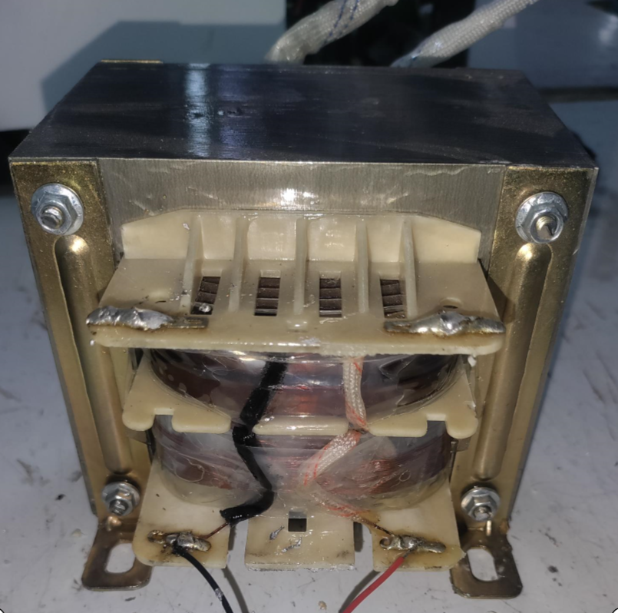
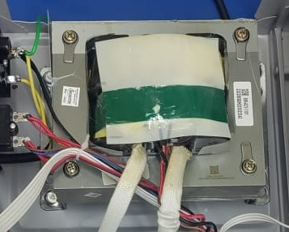
Main Transformer
Su-vastika 950VA Aluminium+Copper Transformer
Microtek 950VA Aluminium Transformer
Light weight and small size
Heavy weight and bigger size

Slide 4
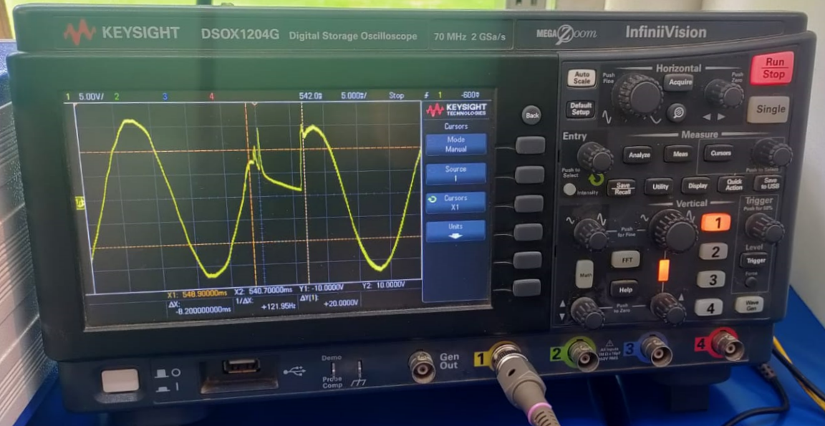
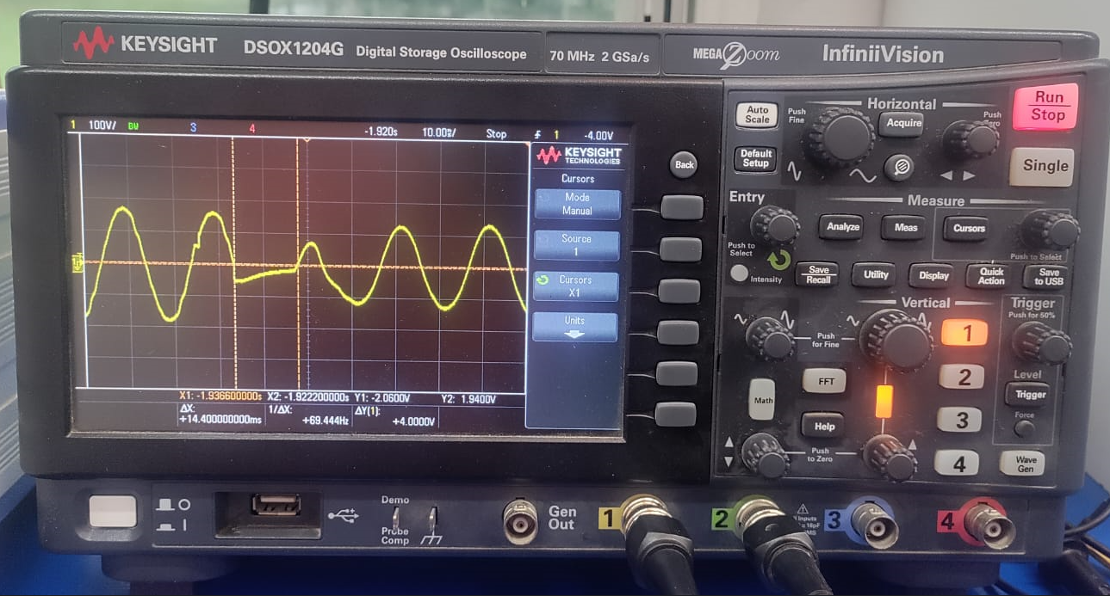
Changeover Time with waveform
14.4ms changeover time in Microtek inverter
8.2ms changeover time in Su-vastika inverter

Slide 5
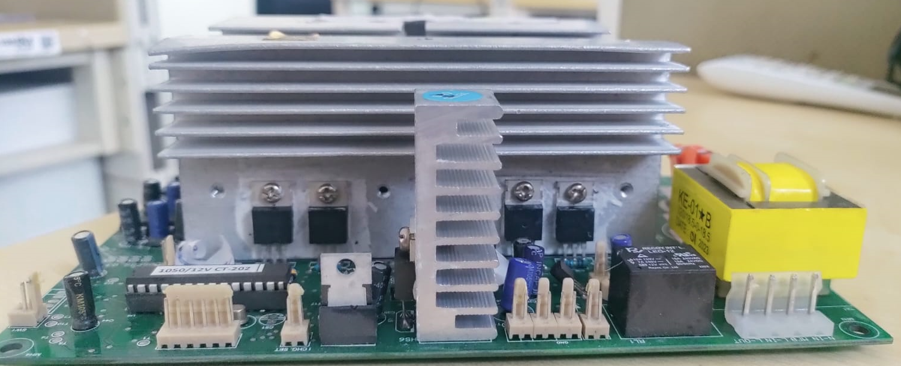
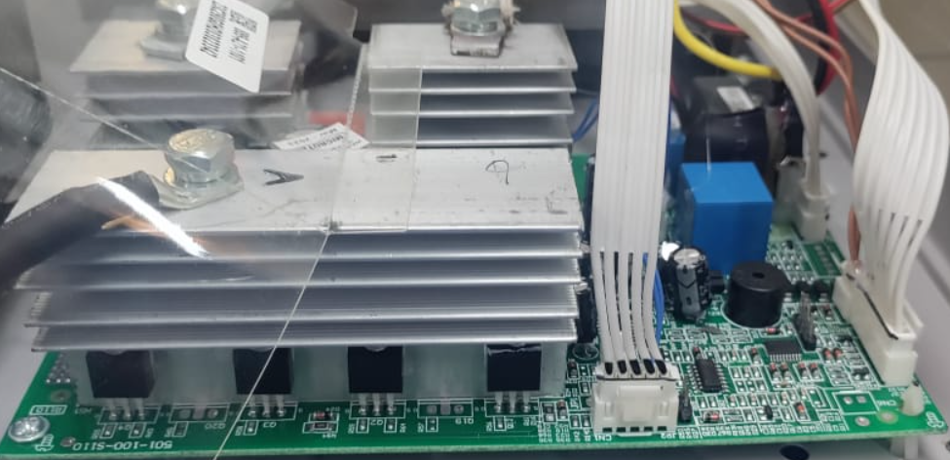
Heatsink of Inverter PCB
Microtek Inverters have a small heatsink on PCB
Su-vastika Inverter have the bigger heatsink on PCB

